Slide 1
in ur webserver, writin’ ur logs
An example domain specific policy language based on lolcats

Slide 2
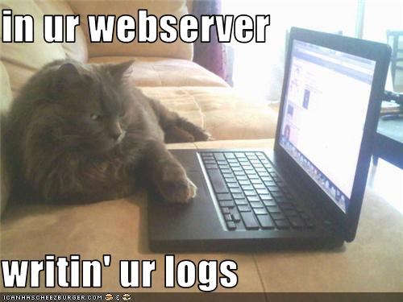
Oh hai! (Introduction)
Notes:
Audience
My Background

Slide 3
SELinux is simple
shadow_t
user_t
?

Slide 4
SELinux is simple
shadow_t
user_t
ü
Allow user_t shadow_t : file read

Slide 5
SELinux is simple
shadow_t
user_t
X

Slide 6
SELinux has complicated features
“RBAC”
MLS
Labeled networking
Userspace object managers
Linux user -> SELinux user mapping
Conditional policy
Crazy management tools
Binary modules
Fine granularity

Slide 7
Linux is complicated
49 object classes
Hundreds of permissions
Pseudo filesystems
Devices
Everything is a file (except what isn’t)
Device drivers all behave slightly differently

Slide 8
Linux distro’s are more complicated
Crazy init systems
Crazy interprocess systems (Dbus)
Not only for communication, launches apps!
Crazy device management (udev)
X
Hundreds/thousands of apps
Complex filesystems
And different between distros

Slide 9
Reference Policy (The original HLL)
Fake abstractions
Almost 7000 interfaces (3200 excluding corenet)
328 modules
Primarily m4 based
1000 lines of Make
2000 lines of Python
Various sed, awk, grep

Slide 10
CIL
Intermediate policy language
Allows high level languages to be written
Might make refpolicy make/m4 compiler go away
Provides native abstractions

Slide 11
CIL
Not addressing other complicated features
Will attempt to clean up some of the management layer
Boring!!

Slide 12
lolpolicy

Slide 13
lolpolicy

Slide 14
lolpolicy
Verbs
writin’
readin’; watchin’
shreddin’; destroyin’
talkin’; usin’
om nom nom
Scoping
in; on

Slide 15
lolpolicy
Nouns (or article)
ur; meh; teh
Subjects
I iz; I are
Special nouns
internets; webz; interwebz
computer; ‘puter
Other words ignored (add as many as you want)
Ex: oh hai, OMG wau!! I needz axxess to deez filez

Slide 16
lolpolicy -> CIL
lolpolicy:
I are logwatch
in ur apache
destroyin‘ ur logs
CIL:
(in logwatch
(call apache.manage_log process))

Slide 17
lolpolicy -> CIL
I iz mysql
usin’ ur webz
(in mysql
(allow process self tcp_socket (create write foo bar))
(allow process self udp_socket (create write foo bar))
(call corenet.all_recvfrom_unlabeled process)
...
(call corenet.all_recvfrom_labeled process process)
(optional init
(call init.tcp_recvfrom_all_daemons process)
(call init.udp_recvfrom_all_daemons process))

Slide 18
lolpolicy -> CIL
I iz staff
in ur apache
om nom nom
(in apache
(transform (type $foo)
(type foo)
(allow staff.process foo file (*))
(allow staff.process foo dir (*))
...

Slide 19
Why?
Why not?
Demonstrate CIL
Show that we aren’t a bunch of stuffy security people (maybe some of us are)

Slide 20
KThxBai!

